Slide 1
Mobile Communications
Chapter 4: Wireless Telecommunication Systems
Market
GSM
  Overview
  Services
  Sub-systems
  Components
DECT
TETRA
UMTS/IMT-2000
Mobile Communications: Wireless Telecommunication Systems
4.0.1

Slide 2
Mobile phone subscribers worldwide
700000
600000
500000
Analog total
GSM total
400000
CDMA total
subscribers (x 1000)
300000
TDMA total
PDC/PHS total
200000
total
100000
0
1996
1997
1998
1999
2000
2001
Mobile Communications: Wireless Telecommunication Systems
4.1.1

Slide 3
GSM: Overview
GSM
  formerly: Groupe Spéciale Mobile (founded 1982)
  now: Global System for Mobile Communication
  Pan-European standard (ETSI, European Telecommunications Standardisation Institute)
  simultaneous introduction of essential services in three phases (1991, 1994, 1996) by the European telecommunication administrations (Germany: D1 and D2)
   seamless roaming within Europe possible
  today many providers all over the world use GSM (more than 130 countries in Asia, Africa, Europe, Australia, America)
  more than 100 million subscribers
Mobile Communications: Wireless Telecommunication Systems
4.2.1

Slide 4
Performance characteristics of GSM
Communication
  mobile, wireless communication; support for voice and data services
Total mobility
  international access, chip-card enables use of access points of different providers
Worldwide connectivity
  one number, the network handles localization
High capacity
  better frequency efficiency, smaller cells, more customers per cell
High transmission quality
  high audio quality and reliability for wireless, uninterrupted phone calls at higher speeds (e.g., from cars, trains)
Security functions
  access control, authentication via chip-card and PIN
Mobile Communications: Wireless Telecommunication Systems
4.3.1

Slide 5
Disadvantages of GSM
There is no perfect system!!
no end-to-end encryption of user data
no full ISDN bandwidth of 64 kbit/s to the user, no transparent B-channel
reduced concentration while driving
electromagnetic radiation
abuse of private data possible
roaming profiles accessible
high complexity of the system
several incompatibilities within the GSM standards
Mobile Communications: Wireless Telecommunication Systems
4.4.1

Slide 6
GSM: Mobile Services
GSM offers
  several types of connections
    voice connections, data connections, short message service
  multi-service options (combination of basic services)
Three service domains
  Bearer Services
  Telematic Services
  Supplementary Services
bearer services
MS
GSM-PLMN
transit
network
(PSTN, ISDN)
source/
destination
network
TE
MT
TE
R, S
U_{m}
(U, S, R)
tele services
Mobile Communications: Wireless Telecommunication Systems
4.5.1

Slide 7
Bearer Services
Telecommunication services to transfer data between access points
Specification of services up to the terminal interface (OSI layers 1-3)
Different data rates for voice and data (original standard)
  data service (circuit switched)
    synchronous: 2.4, 4.8 or 9.6 kbit/s
    asynchronous: 300 - 1200 bit/s
  data service (packet switched)
    synchronous: 2.4, 4.8 or 9.6 kbit/s
    asynchronous: 300 - 9600 bit/s
Mobile Communications: Wireless Telecommunication Systems
4.6.1

Slide 8
Tele Services I
Telecommunication services that enable voice communication via mobile phones
All these basic services have to obey cellular functions, security measurements etc.
Offered services
  mobile telephony
  primary goal of GSM was to enable mobile telephony offering the traditional bandwidth of 3.1 kHz
  Emergency number
  common number throughout Europe (112); mandatory for all service providers; free of charge; connection with the highest priority (preemption of other connections possible)
  Multinumbering
  several ISDN phone numbers per user possible
Mobile Communications: Wireless Telecommunication Systems
4.7.1

Slide 9
Tele Services II
Additional services
  Non-Voice-Teleservices
    group 3 fax
    voice mailbox (implemented in the fixed network supporting the mobile terminals)
    electronic mail (MHS, Message Handling System, implemented in the fixed network)
    ...
    Short Message Service (SMS)
    alphanumeric data transmission to/from the mobile terminal using the signaling channel, thus allowing simultaneous use of basic services and SMS
Mobile Communications: Wireless Telecommunication Systems
4.8.1

Slide 10
Supplementary services
Services in addition to the basic services, cannot be offered stand-alone
Similar to ISDN services besides lower bandwidth due to the radio link
May differ between different service providers, countries and protocol versions
Important services
  identification: forwarding of caller number
  suppression of number forwarding
  automatic call-back
  conferencing with up to 7 participants
  locking of the mobile terminal (incoming or outgoing calls)
  ...
Mobile Communications: Wireless Telecommunication Systems
4.9.1

Slide 11
Architecture of the GSM system
GSM is a PLMN (Public Land Mobile Network)
  several providers setup mobile networks following the GSM standard within each country
  components
    MS (mobile station)
    BS (base station)
    MSC (mobile switching center)
    LR (location register)
  subsystems
    RSS (radio subsystem): covers all radio aspects
    NSS (network and switching subsystem): call forwarding, handover, switching
    OSS (operation subsystem): management of the network
Mobile Communications: Wireless Telecommunication Systems
4.10.1

Slide 12
GSM: overview
OMC, EIR,
AUC
HLR
fixed network
GMSC
NSS
with OSS
VLR
MSC
VLR
MSC
BSC
BSC
RSS
Mobile Communications: Wireless Telecommunication Systems
4.11.1

Slide 13
GSM: elements and interfaces
radio cell
MS
MS
BSS
U_{m}
radio cell
RSS
BTS
MS
BTS
A_{bis}
BSC
BSC
A
MSC
MSC
NSS
VLR
VLR
signaling
HLR
GMSC
ISDN, PSTN
IWF
PDN
O
OSS
EIR
AUC
OMC
Mobile Communications: Wireless Telecommunication Systems
4.12.1

Slide 14
GSM: system architecture
radio
subsystem
network and switching subsystem
fixed
partner networks
MS
MS
ISDN
PSTN
U_{m}
MSC
BTS
A_{bis}
BSC
EIR
BTS
SS7
HLR
BTS
VLR
BSC
ISDN
PSTN
BTS
A
MSC
BSS
IWF
PSPDN
CSPDN
Mobile Communications: Wireless Telecommunication Systems
4.13.1

Slide 15
System architecture: radio subsystem
radio
subsystem
network and switching
subsystem
MS
MS
Components
  MS (Mobile Station)
  BSS (Base Station Subsystem):
  consisting of
    BTS (Base Transceiver Station):
    sender and receiver
    BSC (Base Station Controller):
    controlling several transceivers
Interfaces
  U_{m} : radio interface
  A_{bis} : standardized, open interface with
  16 kbit/s user channels
  A: standardized, open interface with
  64 kbit/s user channels
U_{m}
BTS
A_{bis}
BSC
MSC
BTS
A
BTS
MSC
BSC
BTS
BSS
Mobile Communications: Wireless Telecommunication Systems
4.14.1

Slide 16
System architecture: network and switching subsystem
network
subsystem
fixed partner
networks
Components
  MSC (Mobile Services Switching Center):
  IWF (Interworking Functions)
  ISDN (Integrated Services Digital Network)
  PSTN (Public Switched Telephone Network)
  PSPDN (Packet Switched Public Data Net.)
  CSPDN (Circuit Switched Public Data Net.)
Databases
  HLR (Home Location Register)
  VLR (Visitor Location Register)
  EIR (Equipment Identity Register)
ISDN
PSTN
MSC
EIR
SS7
HLR
VLR
ISDN
PSTN
MSC
IWF
PSPDN
CSPDN
Mobile Communications: Wireless Telecommunication Systems
4.15.1

Slide 17
Radio subsystem
The Radio Subsystem (RSS) comprises the cellular mobile network up to the switching centers
Components
  Base Station Subsystem (BSS):
    Base Transceiver Station (BTS): radio components including sender, receiver, antenna - if directed antennas are used one BTS can cover several cells
    Base Station Controller (BSC): switching between BTSs, controlling BTSs, managing of network resources, mapping of radio channels (U_{m}) onto terrestrial channels (A interface)
    BSS = BSC + sum(BTS) + interconnection
  Mobile Stations (MS)
Mobile Communications: Wireless Telecommunication Systems
4.16.1

Slide 18
GSM: cellular network
segmentation of the area into cells
possible radio coverage of the cell
idealized shape of the cell
cell
  use of several carrier frequencies
  not the same frequency in adjoining cells
  cell sizes vary from some 100 m up to 35 km depending on user density, geography, transceiver power etc.
  hexagonal shape of cells is idealized (cells overlap, shapes depend on geography)
  if a mobile user changes cells
  ⬇ handover of the connection to the neighbor cell
Mobile Communications: Wireless Telecommunication Systems
4.17.1

Slide 19
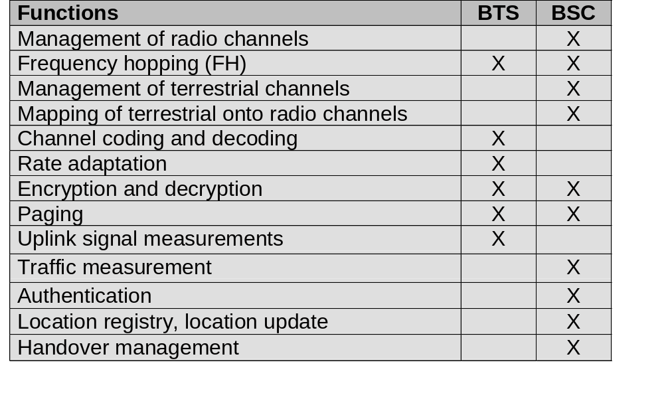
Base Transceiver Station and Base Station Controller
Tasks of a BSS are distributed over BSC and BTS
BTS comprises radio specific functions
BSC is the switching center for radio channels
Mobile Communications: Wireless Telecommunication Systems
4.18.1

Slide 20
Mobile station
Terminal for the use of GSM services
A mobile station (MS) comprises several functional groups
  MT (Mobile Terminal):
    offers common functions used by all services the MS offers
    corresponds to the network termination (NT) of an ISDN access
    end-point of the radio interface (U_{m})
  TA (Terminal Adapter):
    terminal adaptation, hides radio specific characteristics
  TE (Terminal Equipment):
    peripheral device of the MS, offers services to a user
    does not contain GSM specific functions
  SIM (Subscriber Identity Module):
    personalization of the mobile terminal, stores user parameters
TE
TA
MT
R
S
U_{m}
Mobile Communications: Wireless Telecommunication Systems
4.19.1

Slide 21
Network and switching subsystem
NSS is the main component of the public mobile network GSM
  switching, mobility management, interconnection to other networks, system control
Components
  Mobile Services Switching Center (MSC)
  controls all connections via a separated network to/from a mobile terminal within the domain of the MSC - several BSC can belong to a MSC
  Databases (important: scalability, high capacity, low delay)
    Home Location Register (HLR)
    central master database containing user data, permanent and semi-permanent data of all subscribers assigned to the HLR (one provider can have several HLRs)
    Visitor Location Register (VLR)
    local database for a subset of user data, including data about all user currently in the domain of the VLR
Mobile Communications: Wireless Telecommunication Systems
4.20.1

Slide 22
Mobile Services Switching Center
The MSC (mobile switching center) plays a central role in GSM
  switching functions
  additional functions for mobility support
  management of network resources
  interworking functions via Gateway MSC (GMSC)
  integration of several databases
Functions of a MSC
  specific functions for paging and call forwarding
  termination of SS7 (signaling system no. 7)
  mobility specific signaling
  location registration and forwarding of location information
  provision of new services (fax, data calls)
  support of short message service (SMS)
  generation and forwarding of accounting and billing information
Mobile Communications: Wireless Telecommunication Systems
4.21.1

Slide 23
Operation subsystem
The OSS (Operation Subsystem) enables centralized operation, management, and maintenance of all GSM subsystems
Components
  Authentication Center (AUC)
    generates user specific authentication parameters on request of a VLR
    authentication parameters used for authentication of mobile terminals and encryption of user data on the air interface within the GSM system
  Equipment Identity Register (EIR)
    registers GSM mobile stations and user rights
    stolen or malfunctioning mobile stations can be locked and sometimes even localized
  Operation and Maintenance Center (OMC)
    different control capabilities for the radio subsystem and the network subsystem
Mobile Communications: Wireless Telecommunication Systems
4.22.1

Slide 24
GSM - TDMA/FDMA
935-960 MHz
124 channels (200 kHz)
downlink
frequency
890-915 MHz
124 channels (200 kHz)
uplink
higher GSM frame structures
time
GSM TDMA frame
1
2
3
4
5
6
7
8
4.615 ms
GSM time-slot (normal burst)
guard
space
guard
space
tail
user data
S
Training
S
user data
tail
3 bits
57 bits
1
26 bits
1
57 bits
3
546.5 µs
577 µs
Mobile Communications: Wireless Telecommunication Systems
4.23.1

Slide 25
GSM hierarchy of frames
hyperframe
0
1
2
...
2045
2046
2047
3 h 28 min 53.76 s
superframe
0
1
2
...
48
49
50
6.12 s
0
1
...
24
25
multiframe
0
1
...
24
25
120 ms
0
1
2
...
48
49
50
235.4 ms
frame
0
1
...
6
7
4.615 ms
slot
burst
577 µs
Mobile Communications: Wireless Telecommunication Systems
4.24.1

Slide 26
GSM protocol layers for signaling
U_{m}
A_{bis}
A
MS
BTS
BSC
MSC
CM
CM
MM
MM
RR
RR’
BTSM
BSSAP
BSSAP
RR’
BTSM
SS7
SS7
LAPD_{m}
LAPD_{m}
LAPD
LAPD
radio
radio
PCM
PCM
PCM
PCM
16/64 kbit/s
64 kbit/s /
2.048 Mbit/s
Mobile Communications: Wireless Telecommunication Systems
4.25.1

Slide 27

Mobile Terminated Call
1: calling a GSM subscriber
2: forwarding call to GMSC
3: signal call setup to HLR
4, 5: request MSRN from VLR
6: forward responsible
MSC to GMSC
7: forward call to
current MSC
8, 9: get current status of MS
10, 11: paging of MS
12, 13: MS answers
14, 15: security checks
16, 17: set up connection
4
HLR
VLR
5
8
9
3
6
14
15
calling
station
7
PSTN
GMSC
MSC
1
2
10
10
13
10
16
BSS
BSS
BSS
11
11
11
11
12
17
MS
Mobile Communications: Wireless Telecommunication Systems
4.26.1

Slide 28
Mobile Originated Call
1, 2: connection request
3, 4: security check
5-8: check resources (free circuit)
9-10: set up call
VLR
3
4
6
5
PSTN
GMSC
MSC
7
8
2
9
1
MS
BSS
10
Mobile Communications: Wireless Telecommunication Systems
4.27.1

Slide 29
MTC/MOC
MS
MTC
BTS
MS
MOC
BTS
paging request
channel request
channel request
immediate assignment
immediate assignment
paging response
service request
authentication request
authentication request
authentication response
authentication response
ciphering command
ciphering command
ciphering complete
ciphering complete
setup
setup
call confirmed
call confirmed
assignment command
assignment command
assignment complete
assignment complete
alerting
alerting
connect
connect
connect acknowledge
connect acknowledge
data/speech exchange
data/speech exchange
Mobile Communications: Wireless Telecommunication Systems
4.28.1

Slide 30
4 types of handover
1
2
3
4
MS
MS
MS
MS
BTS
BTS
BTS
BTS
BSC
BSC
BSC
MSC
MSC
Mobile Communications: Wireless Telecommunication Systems
4.29.1

Slide 31
Handover decision
receive level
BTS_{old}
receive level
BTS_{old}
HO_MARGIN
MS
MS
BTS_{old}
BTS_{new}
Mobile Communications: Wireless Telecommunication Systems
4.30.1

Slide 32
Handover procedure
MS
BTS_{old}
BSC_{old}
MSC
BSC_{new}
BTS_{new}
measurement
report
measurement
result
HO decision
HO required
HO request
resource allocation
ch. activation
HO request ack
ch. activation ack
HO command
HO command
HO command
HO access
Link establishment
HO complete
HO complete
clear command
clear command
clear complete
clear complete
Mobile Communications: Wireless Telecommunication Systems
4.31.1

Slide 33
Security in GSM
Security services
  access control/authentication
    user  SIM (Subscriber Identity Module): secret PIN (personal identification number)
    SIM  network: challenge response method
  confidentiality
    voice and signaling encrypted on the wireless link (after successful authentication)
  anonymity
    temporary identity TMSI
    (Temporary Mobile Subscriber Identity)
    newly assigned at each new location update (LUP)
    encrypted transmission
3 algorithms specified in GSM
  A3 for authentication (“secret”, open interface)
  A5 for encryption (standardized)
  A8 for key generation (“secret”, open interface)
“secret”:
A3 and A8 available via the Internet
network providers can use stronger mechanisms
Mobile Communications: Wireless Telecommunication Systems
4.32.1

Slide 34
GSM - authentication
mobile network
SIM
RAND
K_{i}
RAND
RAND
K_{i}
AC
128 bit
128 bit
128 bit
128 bit
A3
A3
SIM
SRES* 32 bit
SRES 32 bit
MSC
SRES* =? SRES
SRES
32 bit
SRES
K_{i}: individual subscriber authentication key SRES: signed response
Mobile Communications: Wireless Telecommunication Systems
4.33.1

Slide 35
GSM - key generation and encryption
mobile network (BTS)
MS with SIM
RAND
K_{i}
RAND
RAND
K_{i}
AC
128 bit
128 bit
128 bit
128 bit
SIM
A8
A8
cipher
key
K_{c}
64 bit
K_{c}
64 bit
data
encrypted
data
SRES
BTS
data
MS
A5
A5
Mobile Communications: Wireless Telecommunication Systems
4.34.1

Slide 36
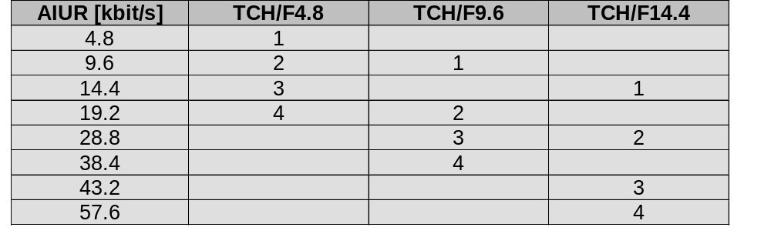
Data services in GSM I
Data transmission standardized with only 9.6 kbit/s
  advanced coding allows 14,4 kbit/s
  not enough for Internet and multimedia applications
HSCSD (High-Speed Circuit Switched Data)
  already standardized
  bundling of several time-slots to get higher
  AIUR (Air Interface User Rate)
  (e.g., 57.6 kbit/s using 4 slots, 14.4 each)
  advantage: ready to use, constant quality, simple
  disadvantage: channels blocked for voice transmission
Mobile Communications: Wireless Telecommunication Systems
4.35.1

Slide 37
Data services in GSM II
GPRS (General Packet Radio Service)
  packet switching
  using free slots only if data packets ready to send
  (e.g., 115 kbit/s using 8 slots temporarily)
  standardization 1998, introduction 2000?
  advantage: one step towards UMTS, more flexible
  disadvantage: more investment needed
GPRS network elements
  GSN (GPRS Support Nodes): GGSN and SGSN
  GGSN (Gateway GSN)
    interworking unit between GPRS and PDN (Packet Data Network)
  SGSN (Serving GSN)
    supports the MS (location, billing, security)
  GR (GPRS Register)
    user addresses
Mobile Communications: Wireless Telecommunication Systems
4.36.1

Slide 38
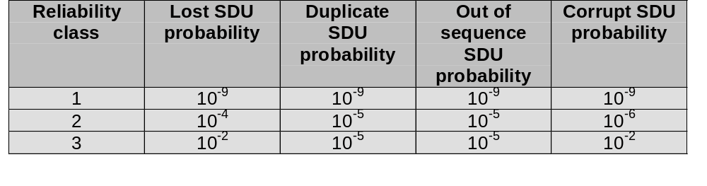
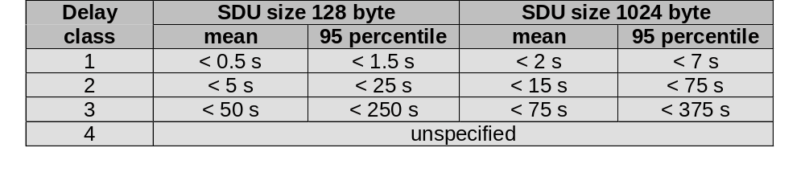
GPRS quality of service
Mobile Communications: Wireless Telecommunication Systems
4.37.1

Slide 39
GPRS architecture and interfaces
SGSN
G_{n}
MS
BSS
SGSN
GGSN
PDN
U_{m}
G_{b}
G_{n}
G_{i}
HLR/
GR
MSC
VLR
EIR
Mobile Communications: Wireless Telecommunication Systems
4.38.1

Slide 40
GPRS protocol architecture
MS
U_{m}
BSS
G_{b}
SGSN
G_{n}
GGSN
G_{i}
apps.
IP/X.25
IP/X.25
SNDCP
SNDCP
GTP
GTP
LLC
LLC
UDP/TCP
UDP/TCP
RLC
RLC
BSSGP
BSSGP
IP
IP
MAC
MAC
FR
FR
L1/L2
L1/L2
radio
radio
Mobile Communications: Wireless Telecommunication Systems
4.39.1

Slide 41
DECT
DECT (Digital European Cordless Telephone) standardized by ETSI (ETS 300.175-x) for cordless telephones
standard describes air interface between base-station and mobile phone
DECT has been renamed for international marketing reasons into „Digital Enhanced Cordless Telecommunication“
Characteristics
  frequency: 1880-1990 MHz
  channels: 120 full duplex
  duplex mechanism: TDD (Time Division Duplex) with 10 ms frame length
  multplexing scheme: FDMA with 10 carrier frequencies,
  TDMA with 2x 12 slots
  modulation: digital, Gaußian Minimum Shift Key (GMSK)
  power: 10 mW average (max. 250 mW)
  range: ca 50 m in buildings, 300 m open space
Mobile Communications: Wireless Telecommunication Systems
4.40.1

Slide 42
DECT system architecture reference model
D₄
D₃
VDB
D₂
PA
PT
FT
local
network
HDB
PA
PT
D₁
global
network
FT
local
network
Mobile Communications: Wireless Telecommunication Systems
4.41.1

Slide 43
DECT reference model
C-Plane
U-Plane
close to the OSI reference model
management plane over all layers
several services in C(ontrol)- and U(ser)-plane
signaling,
interworking
application
processes
network
layer
OSI layer 3
data link
control
management
data link
control
OSI layer 2
medium access control
physical layer
OSI layer 1
Mobile Communications: Wireless Telecommunication Systems
4.42.1

Slide 44
DECT layers I
Physical layer
  modulation/demodulation
  generation of the physical channel structure with a guaranteed throughput
  controlling of radio transmission
    channel assignment on request of the MAC layer
    detection of incoming signals
    sender/receiver synchronization
    collecting status information for the management plane
MAC layer
  maintaining basic services, activating/deactivating physical channels
  multiplexing of logical channels
    e.g., C: signaling, I: user data, P: paging, Q: broadcast
  segmentation/reassembly
  error control/error correction
Mobile Communications: Wireless Telecommunication Systems
4.43.1

Slide 45
DECT time multiplex frame
1 frame = 10 ms
12 down slots
12 up slots
slot
guard
420 bit + 52 µs guard time („60 bit“)
in 0.4167 ms
0
419
sync
D field
0
31
0
387
A: network control
B: user data
X: transmission quality
A field
B field
X field
0
63
0
319
0
3
25.6 kbit/s
protected
mode
DATA
64
C
16
DATA
64
C
16
DATA
64
C
16
DATA
64
C
16
simplex bearer
unprotected
mode
32 kbit/s
DATA
Mobile Communications: Wireless Telecommunication Systems
4.44.2

Slide 46
DECT layers II
Data link control layer
  creation and keeping up reliable connections between the mobile terminal and basestation
  two DLC protocols for the control plane (C-Plane)
    connectionless broadcast service:
    paging functionality
    Lc+LAPC protocol:
    in-call signaling (similar to LAPD within ISDN), adapted to the underlying MAC service
  several services specified for the user plane (U-Plane)
    null-service: offers unmodified MAC services
    frame relay: simple packet transmission
    frame switching: time-bounded packet transmission
    error correcting transmission: uses FEC, for delay critical, time-bounded services
    bandwidth adaptive transmission
    „Escape“ service: for further enhancements of the standard
Mobile Communications: Wireless Telecommunication Systems
4.45.1

Slide 47
DECT layers III
Network layer
  similar to ISDN (Q.931) and GSM (04.08)
  offers services to request, check, reserve, control, and release resources at the basestation and mobile terminal
  resources
    necessary for a wireless connection
    necessary for the connection of the DECT system to the fixed network
  main tasks
    call control: setup, release, negotiation, control
    call independent services: call forwarding, accounting, call redirecting
    mobility management: identity management, authentication, management of the location register
Mobile Communications: Wireless Telecommunication Systems
4.46.2

Slide 48
Enhancements of the standard
Several „DECT Application Profiles“ in addition to the DECT specification
  GAP (Generic Access Profile) standardized by ETSI in 1997
    assures interoperability between DECT equipment of different manufacturers (minimal requirements for voice communication)
    enhanced management capabilities through the fixed network: Cordless Terminal Mobility (CTM)
  DECT/GSM Interworking Profile (GIP): connection to GSM
  ISDN Interworking Profiles (IAP, IIP): connection to ISDN
  Radio Local Loop Access Profile (RAP): public telephone service
  CTM Access Profile (CAP): support for user mobility
DECT
basestation
DECT
Common
Air Interface
DECT
Portable Part
fixed network
GAP
Mobile Communications: Wireless Telecommunication Systems
4.47.1

Slide 49
TETRA - Terrestrial Trunked Radio
Trunked radio systems
  many different radio carriers
  assign single carrier for a short period to one user/group of users
  taxi service, fleet management, rescue teams
  interfaces to public networks, voice and data services
  very reliable, fast call setup, local operation
TETRA - ETSI standard
  formerly: Trans European Trunked Radio
  offers Voice+Data and Packet Data Optimized service
  point-to-point and point-to-multipoint
  ad-hoc and infrastructure networks
  several frequencies: 380-400 MHz, 410-430 MHz
  FDD, DQPSK
  group call, broadcast, sub-second group-call setup
Mobile Communications: Wireless Telecommunication Systems
4.48.1

Slide 50
TDMA structure of the voice+data system
hyperframe
0
1
2
...
57
58
59
61.2 s
multiframe
0
1
2
...
15
16
17
1.02 s
CF
frame
0
1
2
3
56.67 ms
Control Frame
₀ slot ₅₀₉
14.17 ms
Mobile Communications: Wireless Telecommunication Systems
4.49.1

Slide 51
UMTS and IMT-2000
Proposals for IMT-2000 (International Mobile Telecommunications)
  UWC-136, cdma2000, WP-CDMA
  UMTS (Universal Mobile Telecommunications System) from ETSI
UMTS
  UTRA (UMTS Terrestrial Radio Access)
  enhancements of GSM
    EDGE (Enhanced Data rates for GSM Evolution): GSM up to 384 kbit/s
    CAMEL (Customized Application for Mobile Enhanced Logic)
    VHE (virtual Home Environment)
  fits into GMM (Global Multimedia Mobility) initiative from ETSI
  requirements
    min. 144 kbit/s rural (goal: 384 kbit/s)
    min. 384 kbit/s suburban (goal: 512 kbit/s)
    up to 2 Mbit/s city
Mobile Communications: Wireless Telecommunication Systems
4.50.1

Slide 52
UMTS architecture
UTRAN (UTRA Network)
  cell level mobility
  Radio Network Subsystem (RNS)
UE (User Equipment)
CN (Core Network)
  inter system handover
U_{u}
I_{u}
UE
UTRAN
CN
Mobile Communications: Wireless Telecommunication Systems
4.51.1

Slide 53
UMTS FDD frame structure
superframe
W-CDMA
1920-1980 MHz uplink
2110-2170 MHz downlink
chipping rate:
4.096 Mchip/s
soft handover
localization of
MS (ca. 20 m precision)
complex power control
(1600 power control
cycles/s)
720 ms
0
1
2
...
69
70
71
frame
10 ms
0
1
2
...
13
14
15
slot
625 µs
pilot
TPC
TFI
uplink DPCCH
625 µs
data
uplink DPDCH
625 µs
pilot
TPC
TFI
data
downlink DPCH
DPCCH
DPDCH
TPC: Transmit Power Control
TFI: Transport Format Identifier
DPCCH: Dedicated Physical Control Channel
DPDCH: Dedicated Physical Data Channel
DPCH: Dedicated Physical Channel
Mobile Communications: Wireless Telecommunication Systems
4.52.1

Slide 54
UMTS TDD frame structure
frame
10 ms
0
1
2
...
13
14
15
slot
625 µs
data
midample
data
GP
traffic burst
GP: Guard Period
W-TDMA/CDMA
2560 chips per slot
symmetric or asymmetric
slot assignment to up/downlink
tight synchronization needed
simpler power control
(100-800 power control
cycles/s)
Mobile Communications: Wireless Telecommunication Systems
4.53.1

Slide 55
Future mobile telecommunication networks
terminal
mobility
GSM
MBS
(Mobile Broadband System)
fast
UMTS
mobile
DECT
SAMBA
slow
WAND
MEDIAN
portable
ISDN B-ISDN
fixed
10 kbit/s
2 Mbit/s
20 Mbit/s
30 Mbit/s
150 Mbit/s
Mobile Communications: Wireless Telecommunication Systems
4.54.1

